Slide 1
Complex Variable, Laplace & Z- transformation
Lecture 07

Slide 2
This Lecture Covers-
1. Solving Simultaneous Ordinary Differential Equations by Laplace Transform
2. Some examples & exercises on solving simultaneous ODE.

Slide 3
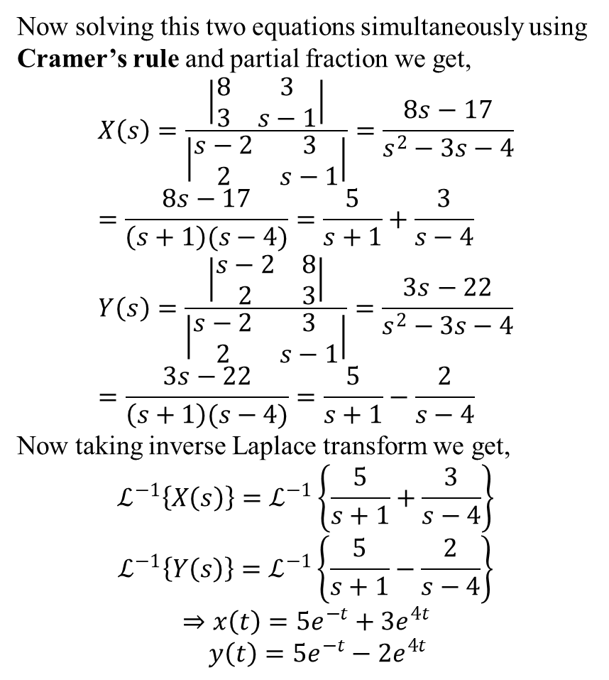
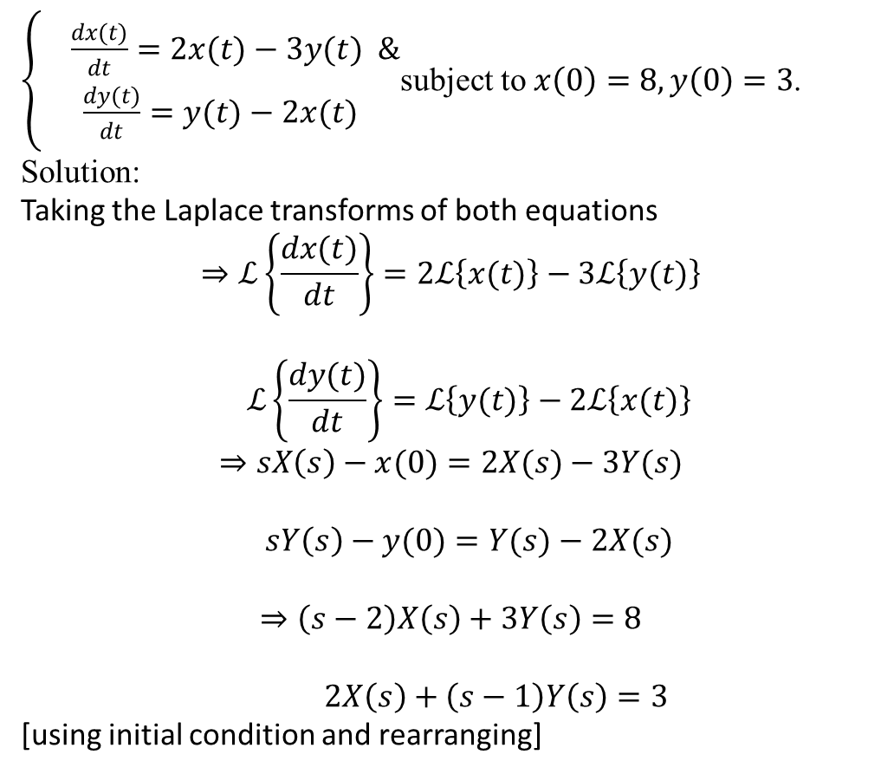
Examples
$\left\{\begin{aligned} \frac{dx(t)}{dt}=2x(t)−3y(t) & \\ \frac{dy(t)}{dt}=y(t)−2x(t)\end{aligned}\right.$subject to $x\left(0\right)=8, y\left(0\right)=3$.
Solution:
Taking the Laplace transforms of both equations
$$⇒ℒ\left\{\frac{dx(t)}{dt}\right\}=2ℒ\left\{x(t)\right\}−3ℒ\left\{y(t)\right\}$$
$$ℒ\left\{\frac{dy(t)}{dt}\right\}=ℒ\left\{y(t)\right\}−2ℒ\left\{x(t)\right\}$$
$$⇒sX\left(s\right)−x(0)=2X(s)−3Y(s)$$
$$sY\left(s\right)−y(0)=Y(s)−2X(s)$$
$$⇒\left(s−2\right)X\left(s\right)+3Y\left(s\right)=8$$
$2X\left(s\right)+\left(s−1\right)Y\left(s\right)=3$
[using initial condition and rearranging]
Now solving this two equations simultaneously using Cramer’s rule and partial fraction we get,
$$X\left(s\right)=\frac{\left|\begin{matrix}8 & 3 \\ 3 & s−1\end{matrix}\right|}{\left|\begin{matrix}s−2 & 3 \\ 2 & s−1\end{matrix}\right|}=\frac{8s−17}{s^{2}−3s−4}=\frac{8s−17}{\left(s+1\right)(s−4)}=\frac{5}{s+1}+\frac{3}{s−4}$$
$$Y\left(s\right)=\frac{\left|\begin{matrix}s−2 & 8 \\ 2 & 3\end{matrix}\right|}{\left|\begin{matrix}s−2 & 3 \\ 2 & s−1\end{matrix}\right|}=\frac{3s−22}{s^{2}−3s−4}=\frac{3s−22}{\left(s+1\right)(s−4)}=\frac{5}{s+1}−\frac{2}{s−4}$$
Now taking inverse Laplace transform we get,
$$ℒ^{−1}\left\{X\left(s\right)\right\}=ℒ^{−1}\left\{\frac{5}{s+1}+\frac{3}{s−4}\right\}$$
$$ℒ^{−1}\left\{Y\left(s\right)\right\}=ℒ^{−1}\left\{\frac{5}{s+1}−\frac{2}{s−4}\right\}$$
$$⇒x\left(t\right)=5e^{−t}+3e^{4t}$$
$$y\left(t\right)=5e^{−t}−2e^{4t}$$

Slide 4

Exercises
Solve the following system of differential equations where $x\left(t\right)≡x$, $y\left(t\right)≡y$, $\dot{y}≡\frac{dy(t)}{dt}$ and $\dot{x}≡\frac{dx(t)}{dt}$, using Laplace transformation. Also justify your answers.
1. $\dot{x}=y$
$$\dot{y}=16x; x\left(0\right)=0, y\left(0\right)=4.$$
2. $\dot{x}=−4y$
$\dot{y}=x; x\left(0\right)=2,y\left(0\right)=0.$
3. $\dot{x}=2x+y$
$\dot{y}=4x+2y;$ $x\left(0\right)=1, y\left(0\right)=6$.
4. $\dot{x}=3x+y$
$\dot{y}=4x+3y;$ $x\left(0\right)=3, y\left(0\right)=2$.

Slide 5
Learning Outcomes
After completing this lecture one can easily solve differential equation and also system of differential equation using Laplace transformation.

Slide 6
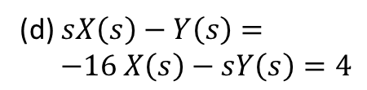


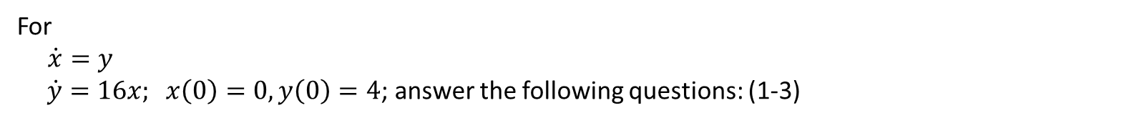

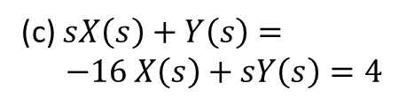

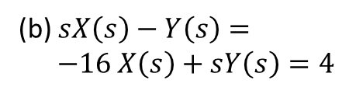


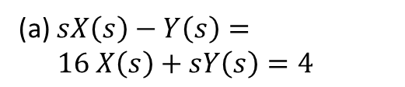


Sample MCQ
For
$\dot{x}=y$
$\dot{y}=16x; x\left(0\right)=0, y\left(0\right)=4$; answer the following questions: (1-3)
1. Which one is the corresponding system of equations in $X\left(x\right)$ and $Y\left(s\right)?$
(a) $sX\left(s\right)−Y\left(s\right)= 16 X\left(s\right)+sY\left(s\right)=4$
(b) $sX\left(s\right)−Y\left(s\right)= −16 X\left(s\right)+sY\left(s\right)=4$
(c) $sX\left(s\right)+Y\left(s\right)= −16 X\left(s\right)+sY\left(s\right)=4$
(d) $sX\left(s\right)−Y\left(s\right)= −16 X\left(s\right)−sY\left(s\right)=4$
2. If we solve the system of equations obtained in 1, then which one is correct for $X\left(s\right)$?
(a) $X\left(s\right)=\frac{2s+4}{s^{2}+16}$
(b) $X\left(s\right)=\frac{2s−4}{s^{2}−16}$
(c) $X\left(s\right)=\frac{2s+4}{s^{2}−16}$
(d) $X\left(s\right)=\frac{s+4}{s^{2}−16}$
3. Evaluate $y\left(t\right)$ for the given system of differential equations:
(a) $4\cosh{4t+8\sinh{4t}}$
(b) $\cosh{4t+8\sinh{4t}}$
(c) $4\cosh{4t−8\sinh{4t}}$
(d) $4\cosh{4t+8\sinh{t}}$

